Slide 1
printable and sustainable global money
+
+
CIFRON

Slide 2
PRINTER
1
2
3
+
You ask for money through the app
Your bank account is checked
Currency conversion is done
MOBILE
4
5
+
+
Your money is made available on the app screen for checking
With your approval, the money is printed through the mobile printer
+

Slide 3
APP
_ X
1
2
+
Process to transfer money can only be executed by scraping the secret code, making the money out of circulation
Through the app you can use QR code to verify availability of money digitally
MOBILE
+
+
3
Alternatively, printed CRIFRON can be passed on as an traditional money as long as the secret code is not scraped and used
+

Slide 4
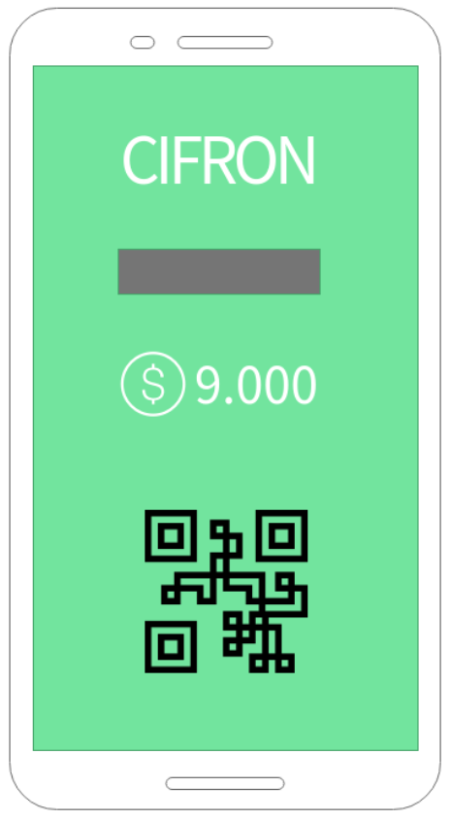
Trackable money
Each interaction with the physical money and the application location data is stored
Sustainable
Recycled paper
Secret code scraped
This code should be scraped to use the money
Printed money
Through our mobile printer you will be able to print physical money
Any currency in the world
You have buying power in your hand, anywhere in the world, at any time and in any currency
QR Code
available for online verification of the veracity of the money
+

Slide 5
+
+
+
But... Why CREATE this?
+
+
+
+
+

Slide 6
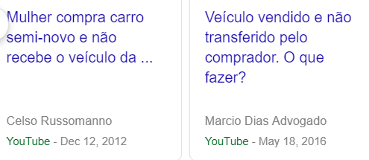
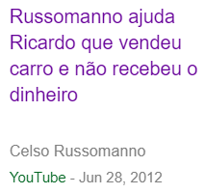
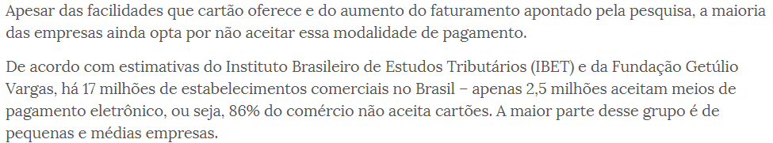
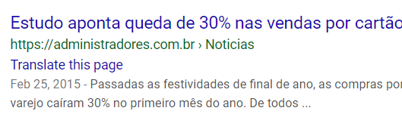

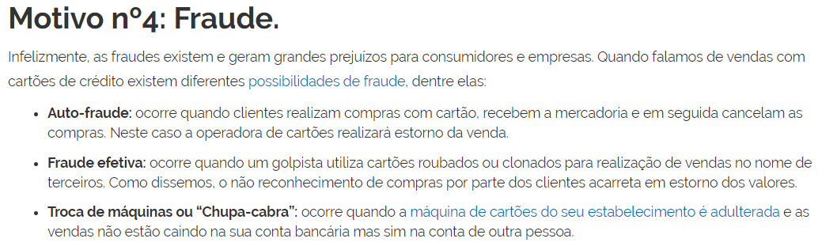
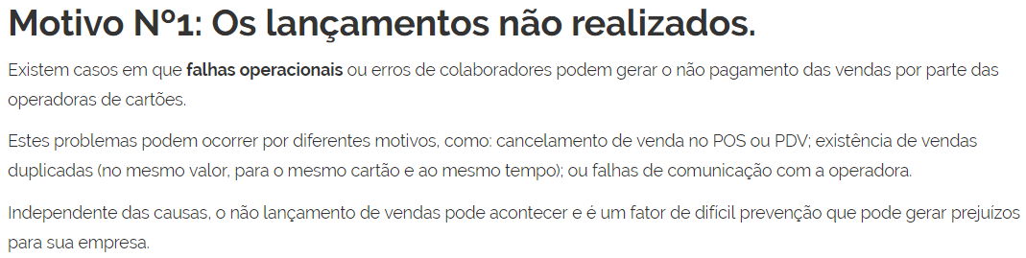
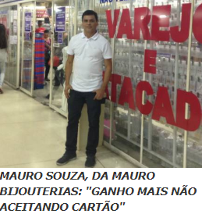
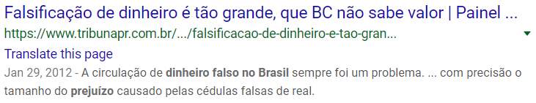
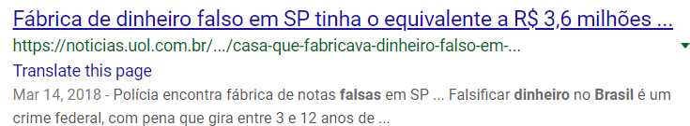
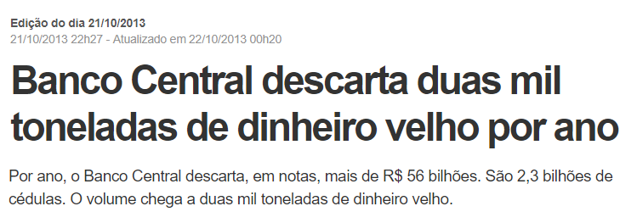
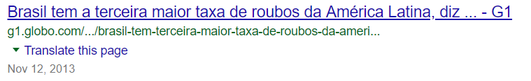
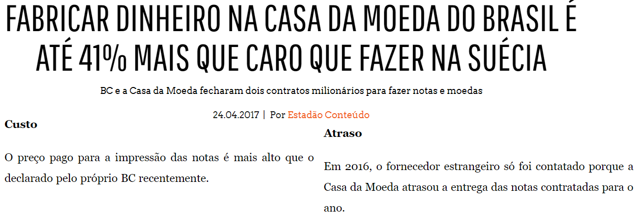
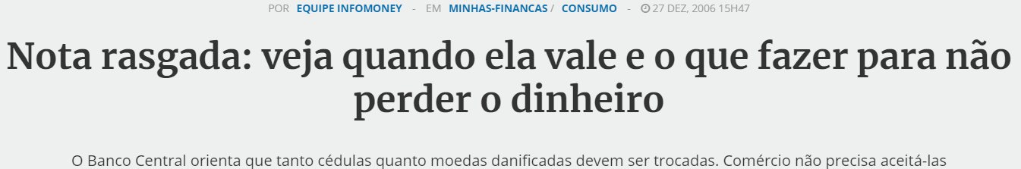
Brazil Facts
Problems with vehicle transfer
where payment was made and the transfer of the document was not made
Having a total of 17 million trades in Brazil, only 2.5 accept cards
30% drop in sales per card
+
Traders say they earn more by not accepting cards
Systemic communication failures at times of sale in card
+
+
But... Why CREATE this?
+
+
+
+
+
Banking delay for transfer of cash in card sales
Quantity of discarded banknotes, generates the high cost of taxes and the worst is not recycled
High cost of manufacturing, Delay, Lack of competition
the current money can not be traced
High cost of manufacturing, Delay, Lack of competition
financial loss or loss of time to change them

Slide 7
We can change this scenario
Benefits of CIFRON
X
X
X
X
Printed money
You can print your own money.
You will no longer need to waste time going to an ATM.
All this with our mobile printer.
Trackable money with blockchain
In cases of theft, if the criminal tries to pass on or use your money, he will need to access our application, so he will be located and the police can take immediate action to recover your money.
Any currency in the world
There was no need to go to a exchange store. You can do everything from wherever you are.
In any currency in the world and anywhere in the world
Everything done digitally
+

Slide 8
We can change this scenario
Benefits of CIFRON
X
X
X
X
Sustainable
Money printed on recyclable paper.
Currently, annually thousands of tons of paper derived from old money are discarded in nature.
Secret code scraped
We have multiple layers of security.
Secret code scraped
QR CODE
Digital Verification
Internal Code
QR Code
Digital verification at the time of receipt, leaving no more possibility for fake money
Systemic communication failure
If you are the buyer, you will be able to buy in situations of faulty systems and if you are the seller can even sell in situations of systemic failure
+

Slide 9
We can change this scenario
Benefits of CIFRON
X
X
Digital
NO FAKE MONEY
Less Taxes
Less Taxes
Less Taxes
We hope that through the circulation of CIFRON can lead to a large reduction of taxes
Just money
You can buy in stores that do not accept card
and if you are a seller you can sell without card
printable money
NO ATM
Money anywhere
Money anywhere
NO theft of money
NO exchange shop
NO RISK
+

Slide 10
+
+
+
How to
make MONEY?
+
+
+
+
+

Slide 11
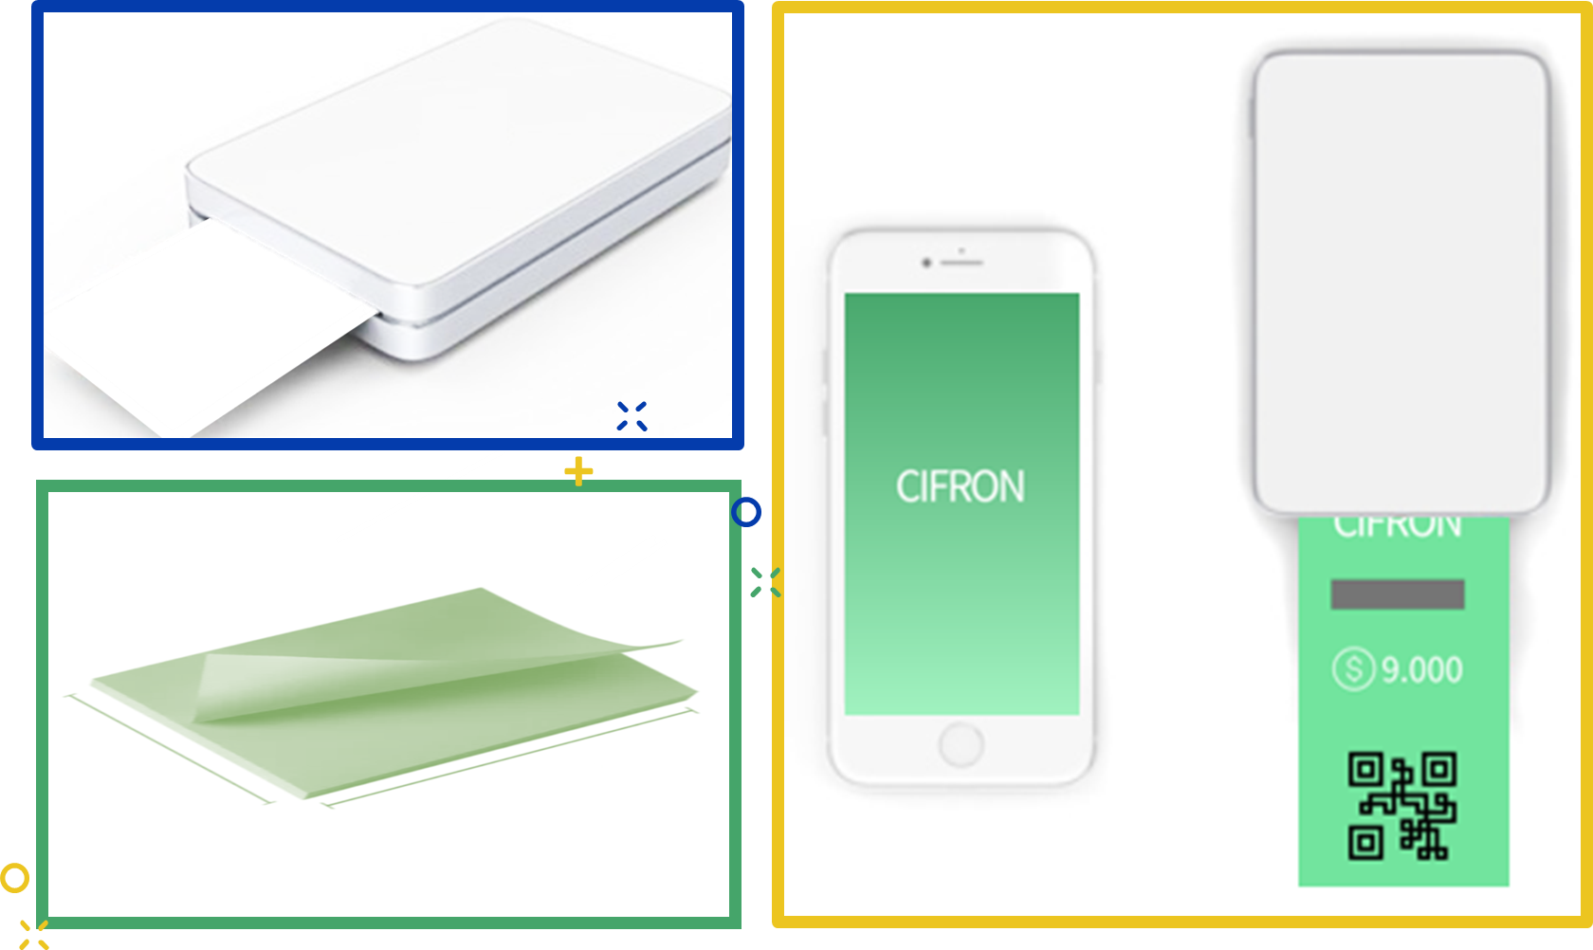
CIFRONPRODUCT

Slide 12
+ Mobile
Printer
+ Mobile
App
Recyclable Paper
Mobile application
Must be distributed at no cost to users.
Partnerships can be made with exchange shops for better day-to-day conversion rates (where a negotiated amount should be agreed upon and passed on to CIFRON), governments (where with the reduction of the government's need to make money. Rates reduction may be negotiated for countries that use CIFRON) and police (where it can be made a partnership to search for criminals through the tracking of money)
Sustainable
The cost of the paper should be the least possible, so all the cost charged and collected by the product should be only for the supply of the recycle stream.
CIFRONPRODUCT
B2B + B2C
The printer should be made from recyclable products and sold at a price that is accessible to all regardless of social class and business owners who do not accept cards or prefer to accept money.

Slide 13
CIFRON DISTRIBUTION CENTER
_ X
+
+
+
+
PRINTER
Mobile
+ Paper
Amazon
Gas Station
Restaurants
Own Website
Fitness center
SuperMarkets
+

Slide 14
IOS
+
+
DISTRIBUTION
B2B
CIFRON App
B2C
Android
+

Slide 15
+
+
Prototypes
CIFRON

Slide 16
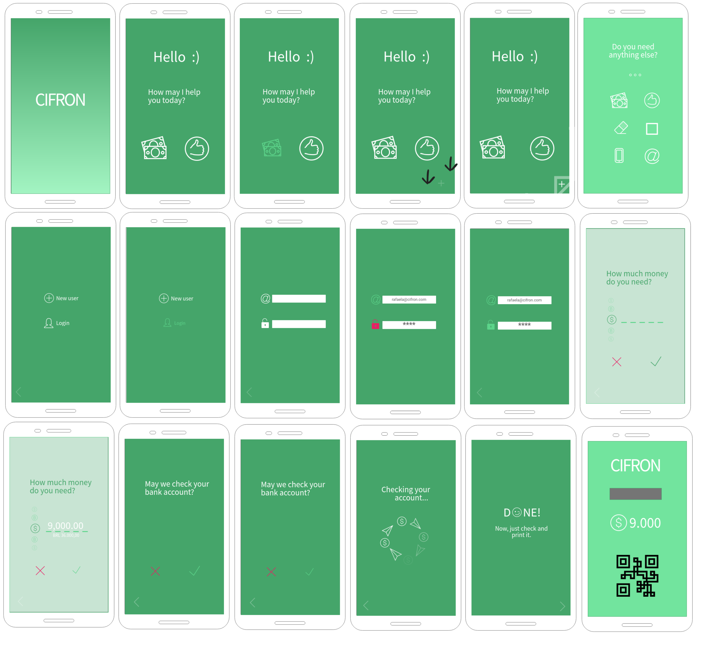
+
CIFRONPRINTING

Slide 17
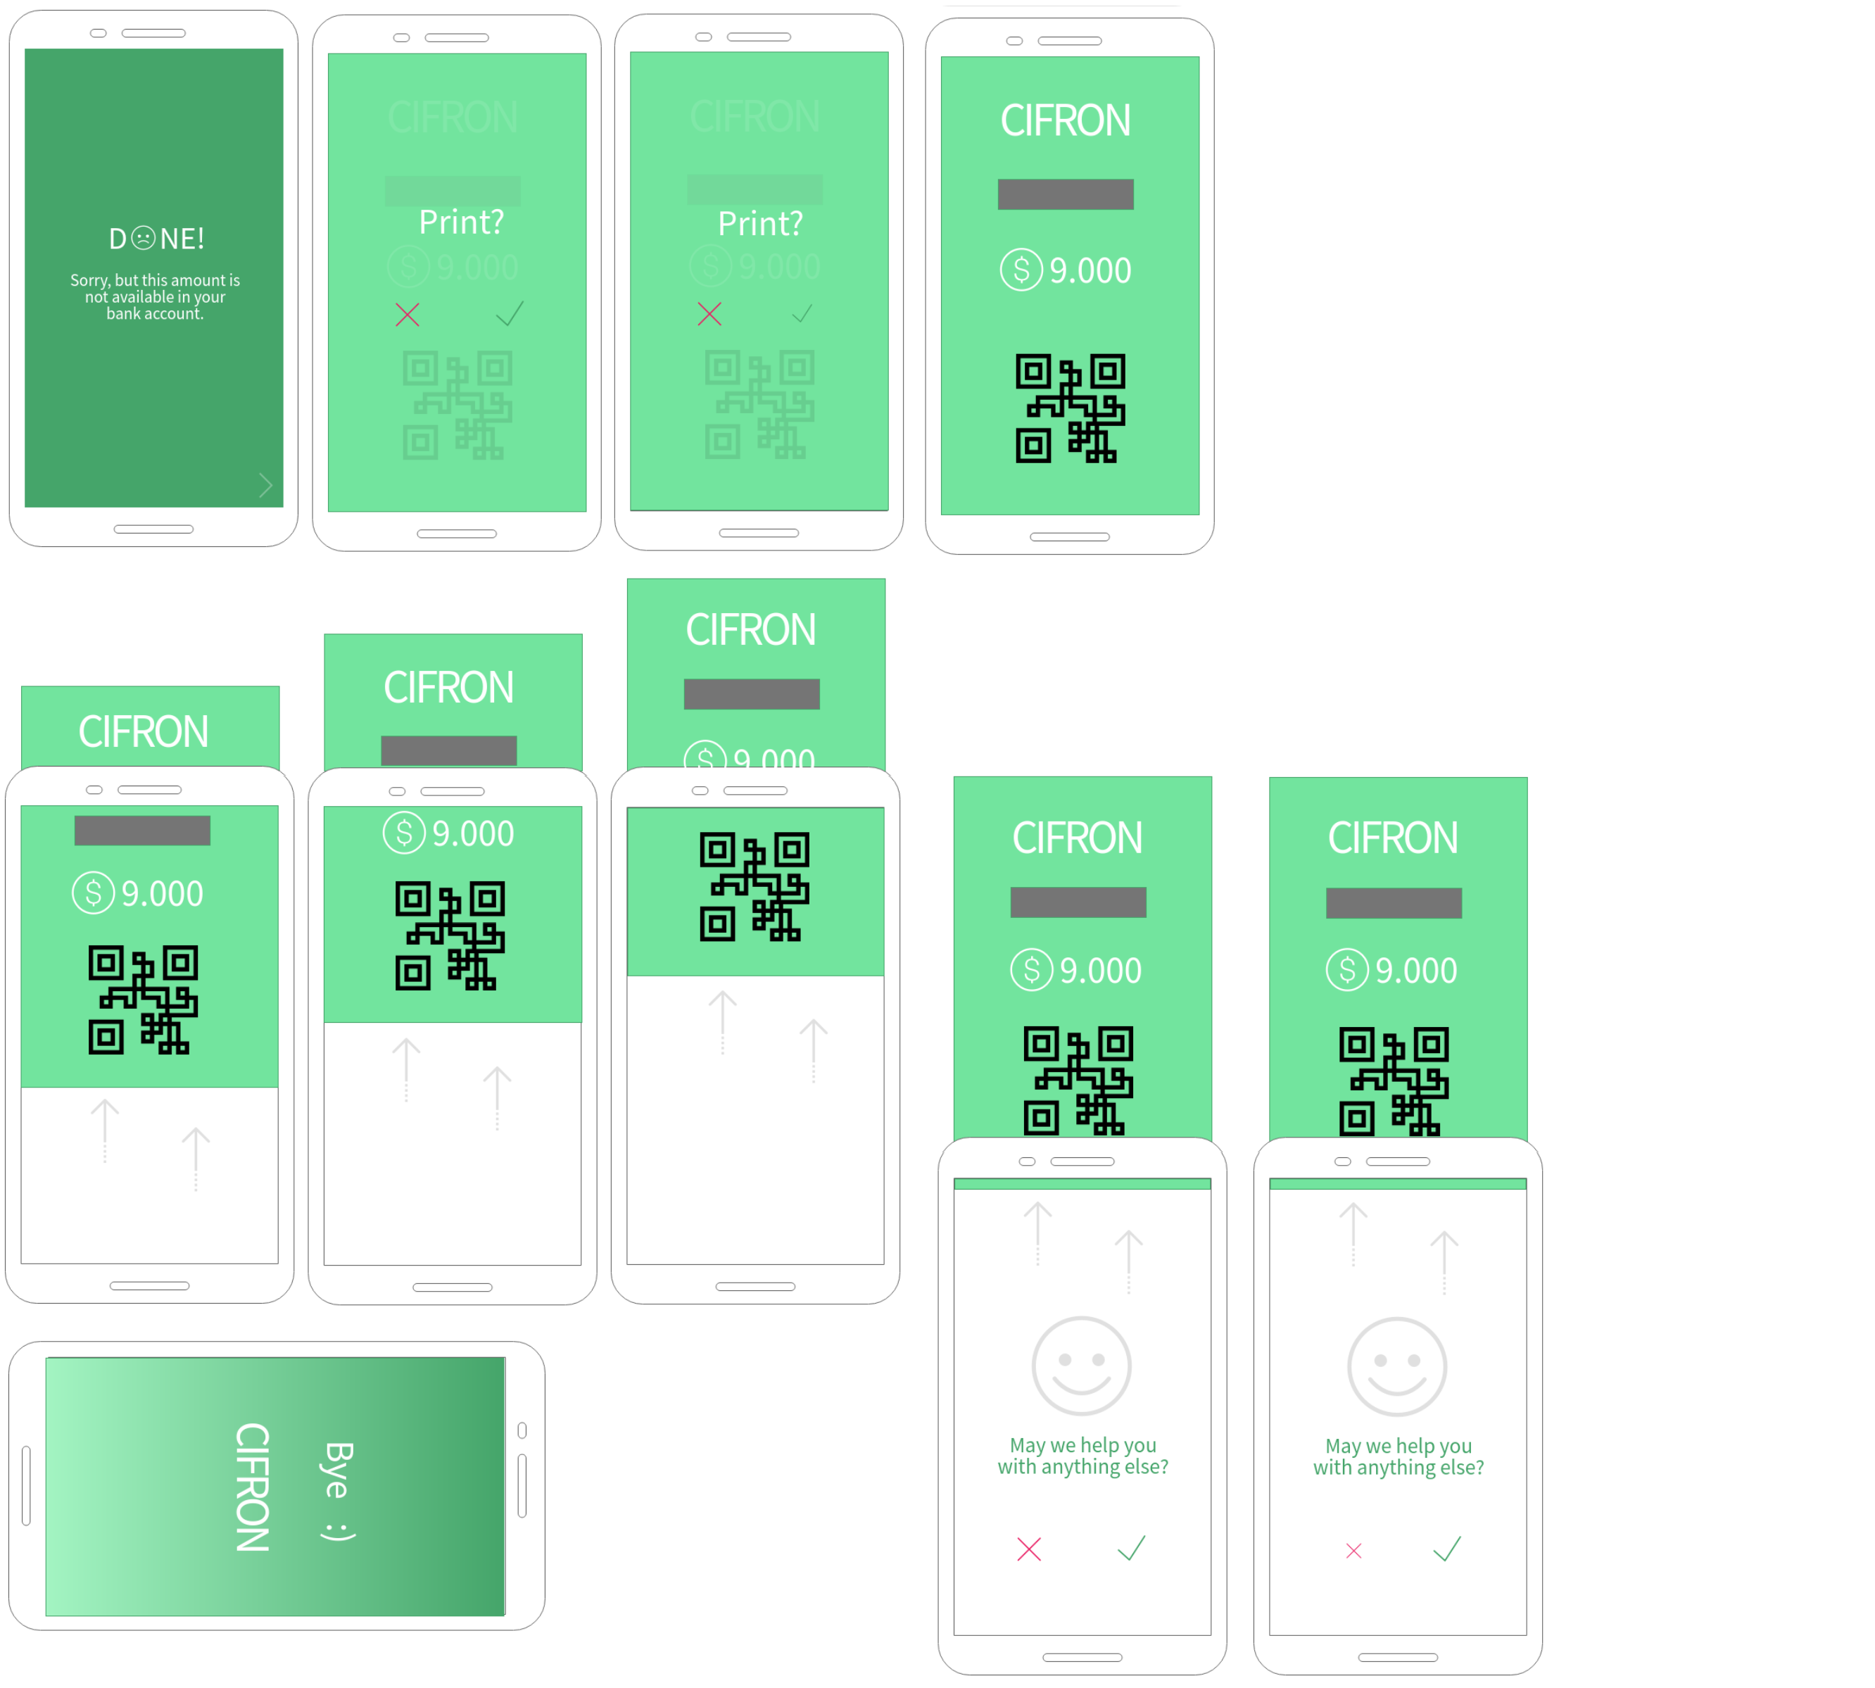
+
CIFRONPRINTING

Slide 18
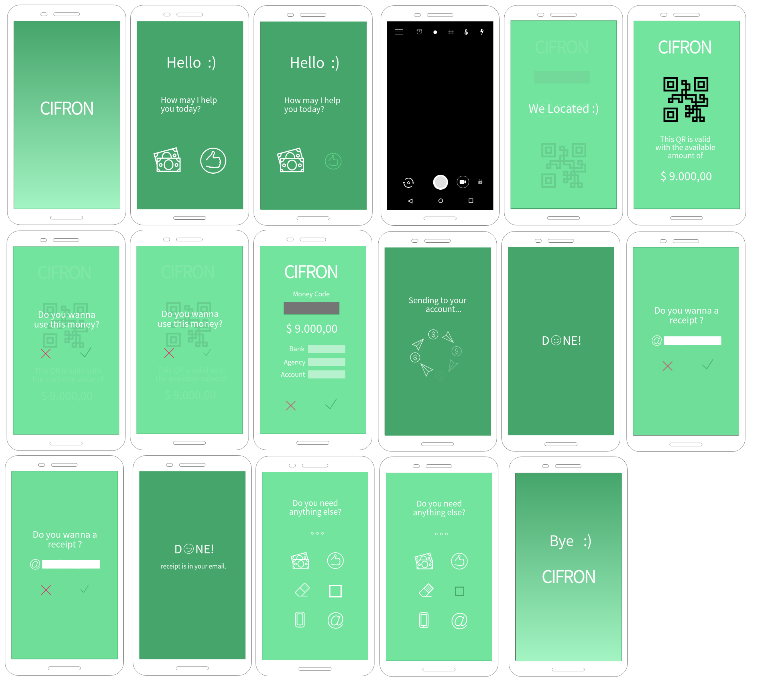
+
CIFRONCHEKING

Slide 19
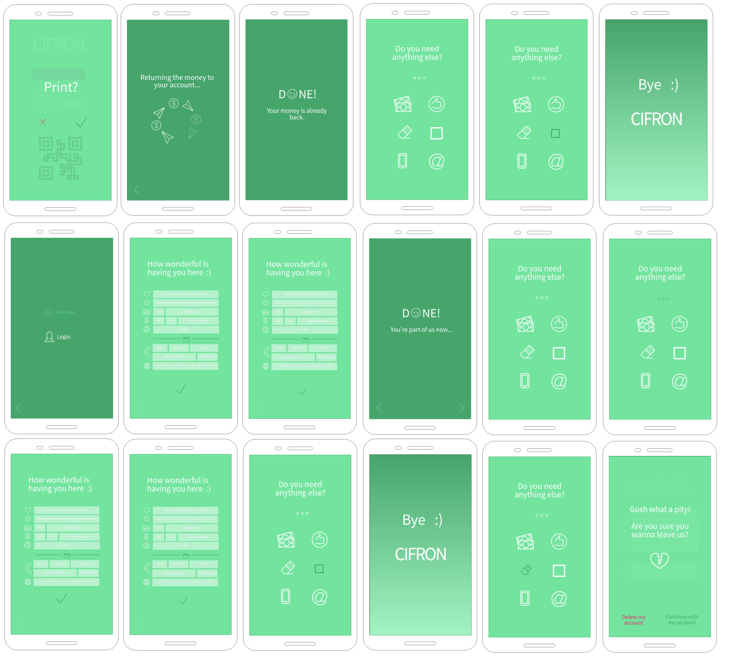
+
CIFRONOTHERS

Slide 20
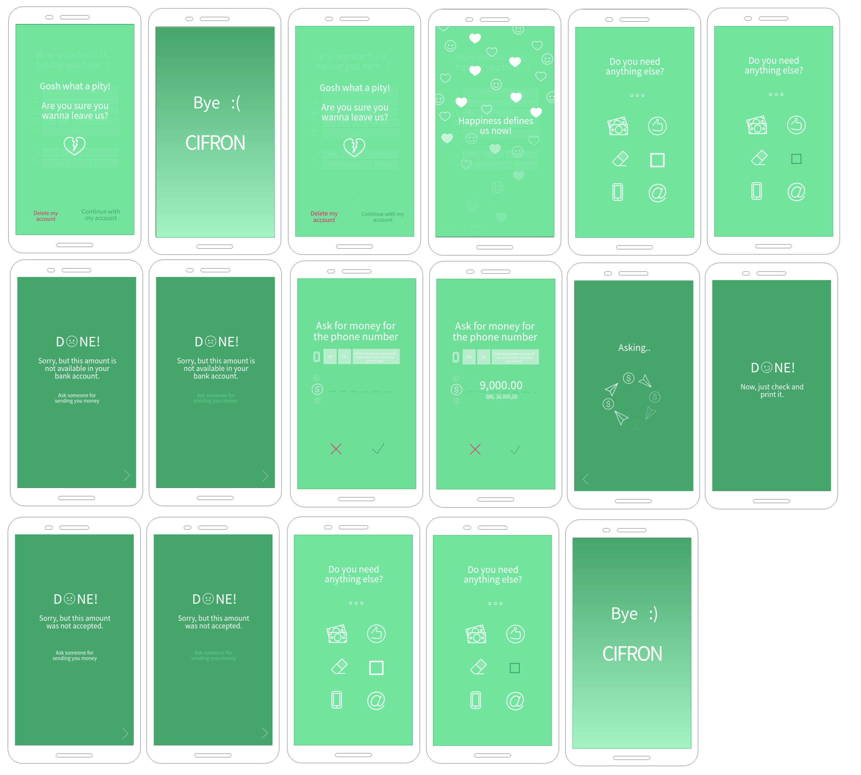
+
CIFRONOTHERS

Slide 21
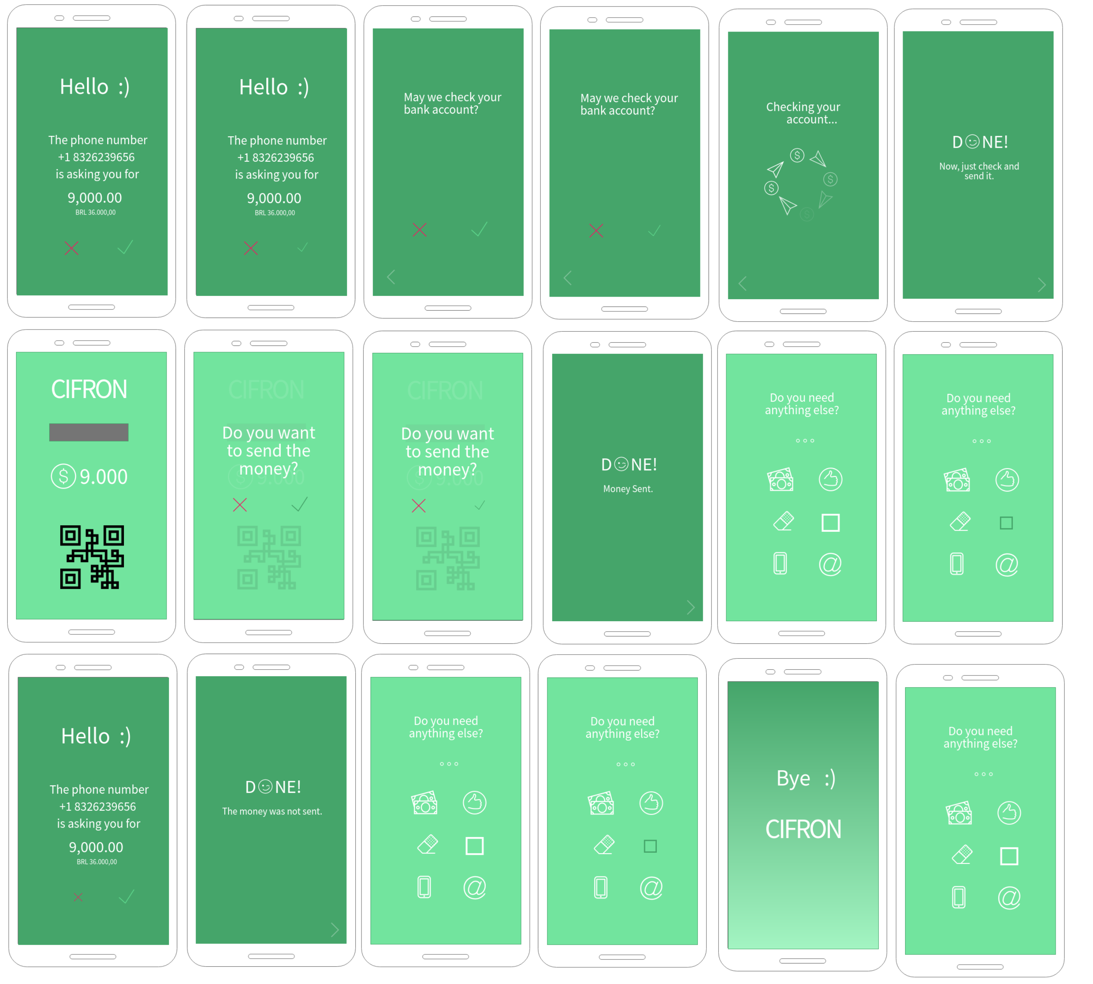
+
CIFRONOTHERS

Slide 22
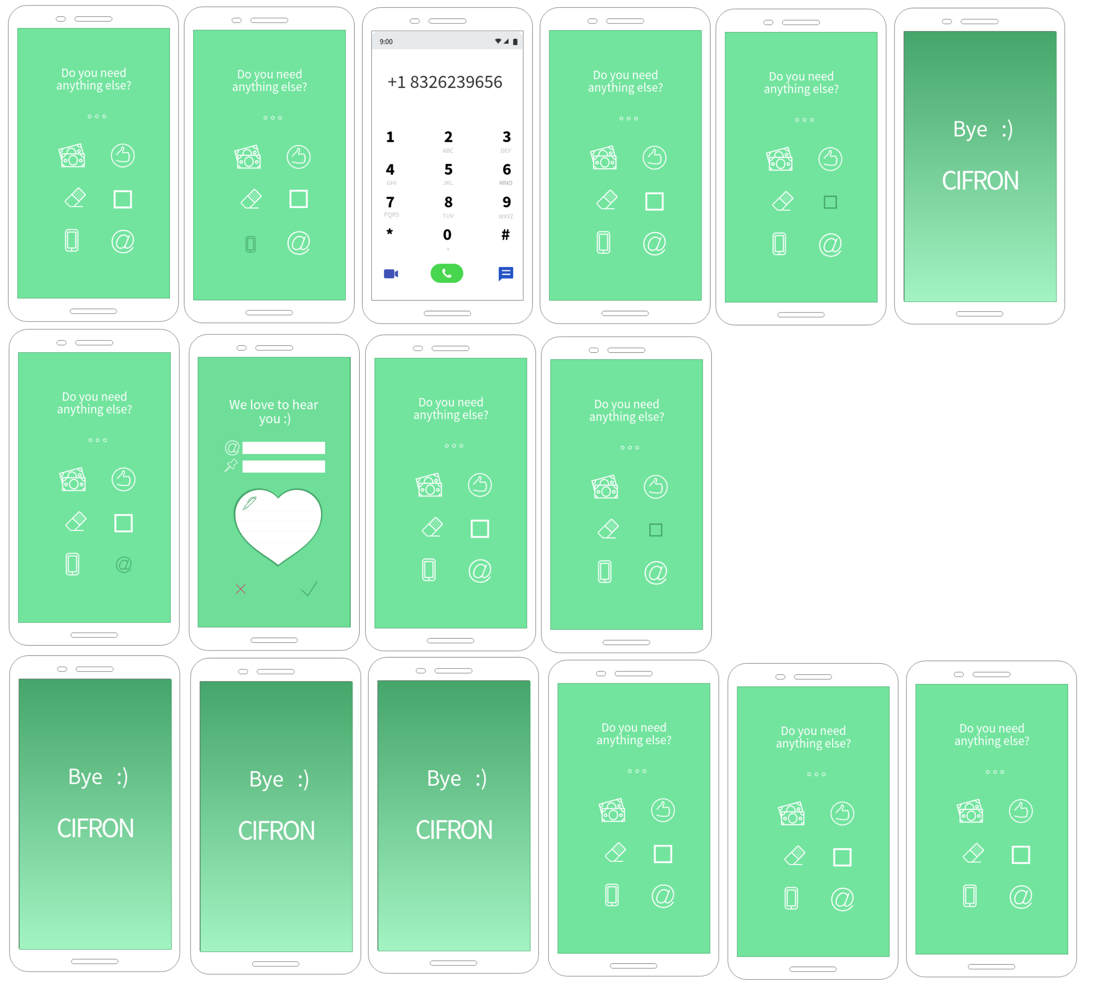
+
CIFRONOTHERS

Slide 23
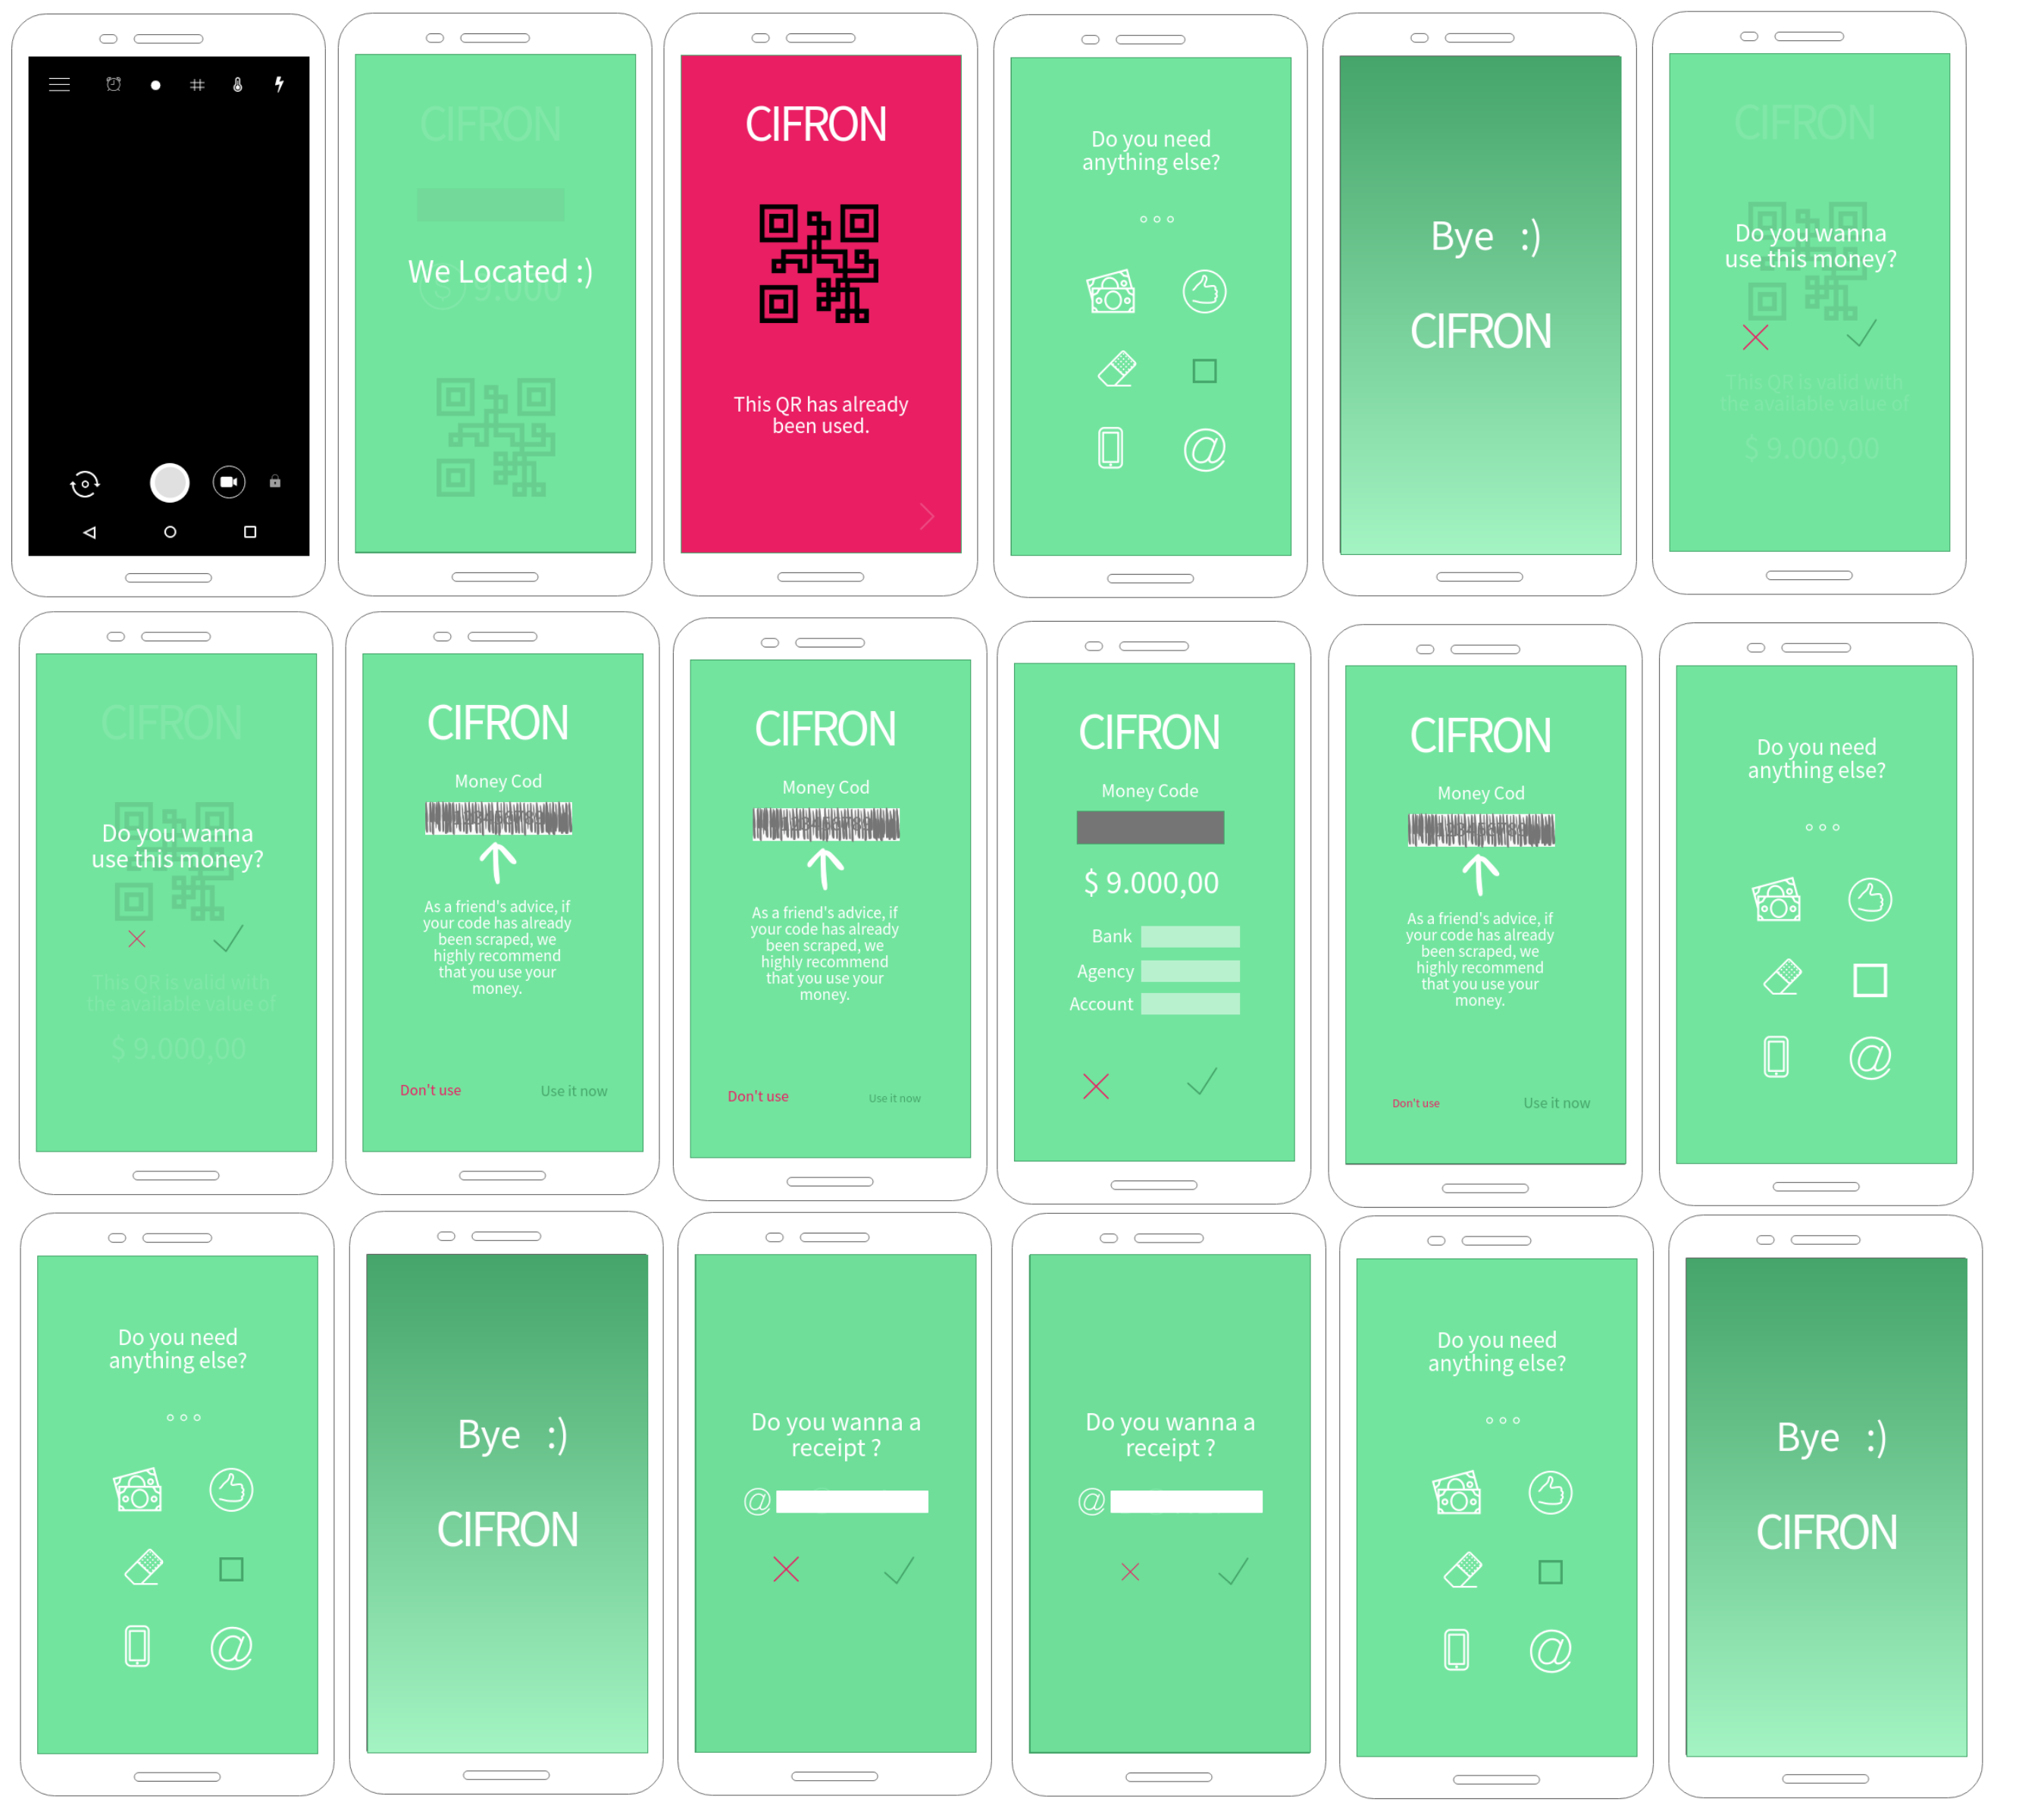
+
CIFRONOTHERS

Slide 24
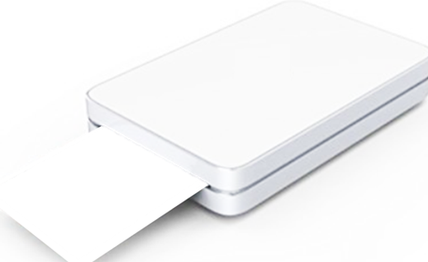
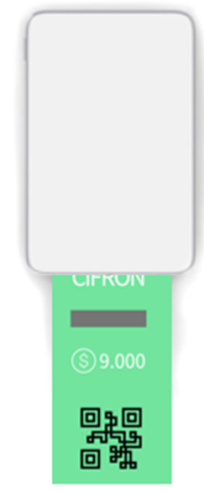
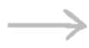

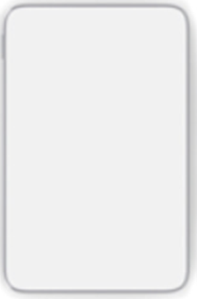



+
the money is printed and will be shipped out
CIFRONPRINTER
Cover
space to fill your paper

Slide 25
Digital transformation has come to physical money
+
+
CIFRON
All rights reserved

